Slide 1
August 6, 2023
HR PRO Advisors
Solving this issue of employee attrition
EVIN MCDONALD, SANJHANA RANGARAJ, MORGAN TUCKER, ANURAG SAHU, KRITTIKA DESHWAL
The University of Texas at Austin

Slide 2
1
4
PROBLEM STATEMENT
INSIGHTS AND CONCLUSION
ENABLING BUSINESS IMPACT
2
5
EXPLORATORY DATA ANALYSIS
Q&A
FEATURE IMPORTANCE & CORRELATION
3
STATISTICAL MODELS EMPLOYED
MEASURES OF SUCCESS AND MODEL COMPARISON

Slide 3

PROBLEM
STATEMENT

Slide 4

PROBLEM STATEMENT
Attrition issue:
15% loss per year
Delayed projects
Reputation issues
Hiring new employees
Constantly training

Slide 5
EXPLORATORY DATA ANALYSIS

Slide 6
DATASET
Data Set:
Received from Kaggle
Info on attrition, salary, education, job role, work/life balance, age, etc.
Data Cleaning:
Clean to begin
Removal of variables
Over 18, Employee Count, Standard Hours, Employee ID
Removal of rows with N/A
2% of data set rows

Slide 7
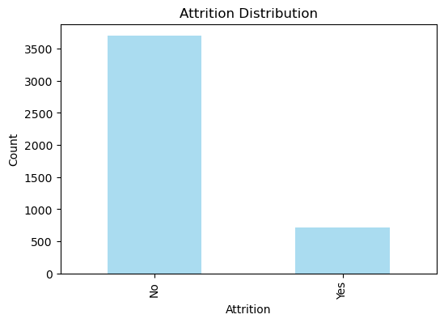
ATTRITION PERCENT

Slide 8
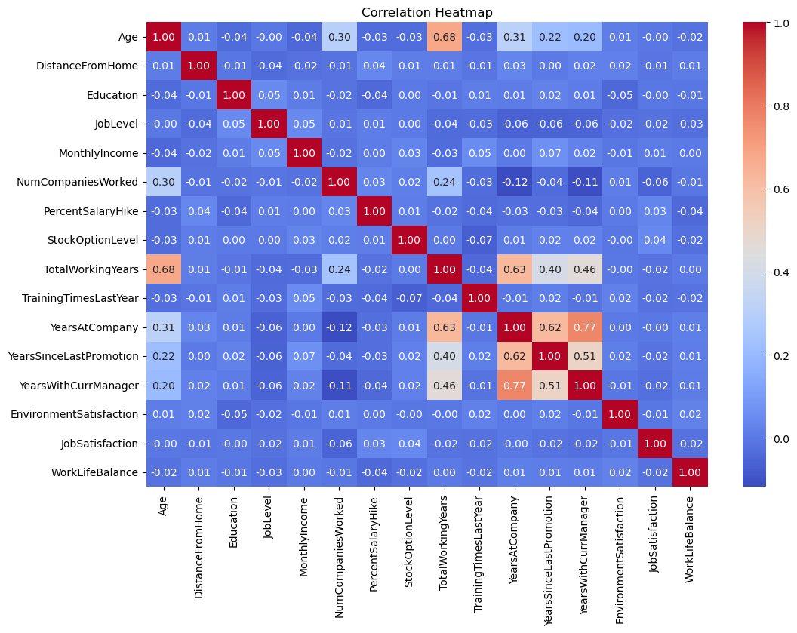
CORRELATION MATRIX

Slide 9
FEATURE SELECTION
CHI-SQUARE TEST
Feature | P-Value | Chi-Square Statistic
Monthly Income | 3.406754498980685e-250 | 3929.3476286931614
Total Working Years | 9.18417443067768e-53 | 355.844895648279
Age | 2.5286895611179176e-49 | 345.4377591418746
Years at company | 7.801586908278778e-41 | 286.7718359721763
Years with current manager | 2.920656398866805e-38 | 224.71653364043806
Marital Status | 5.900236665869354e-29 | 129.99995046772187

Slide 10
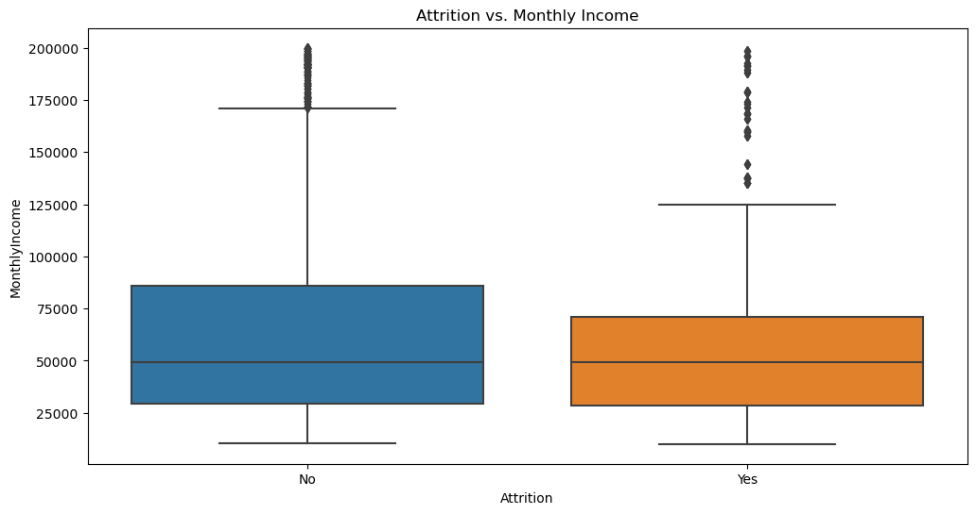
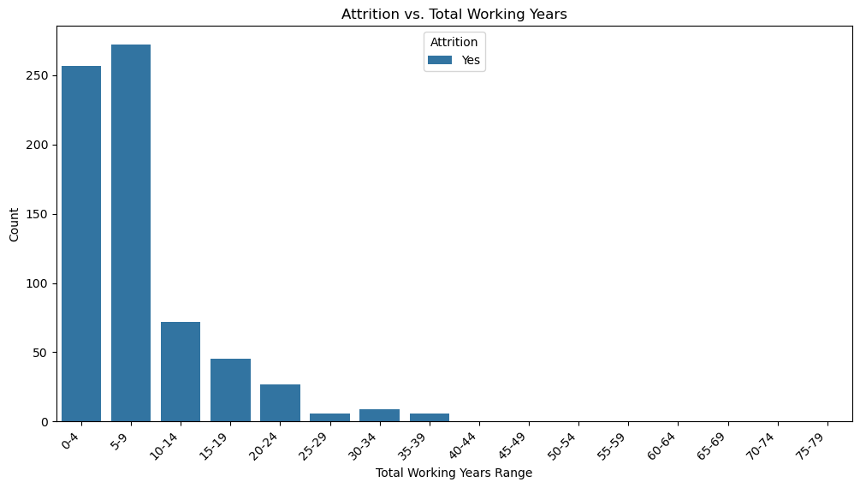
VARIABLES IN DATASET

Slide 11
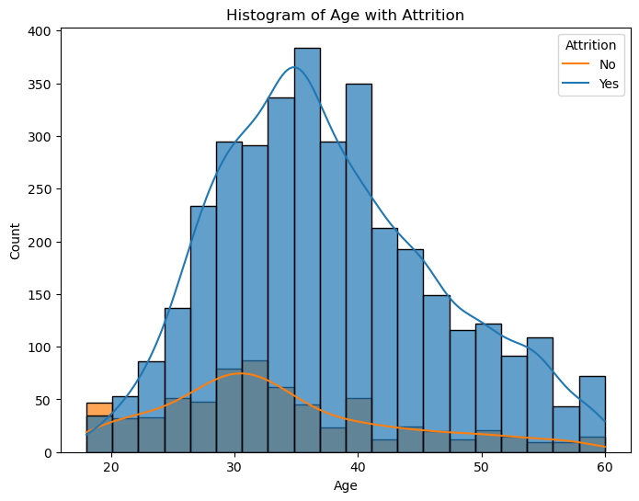
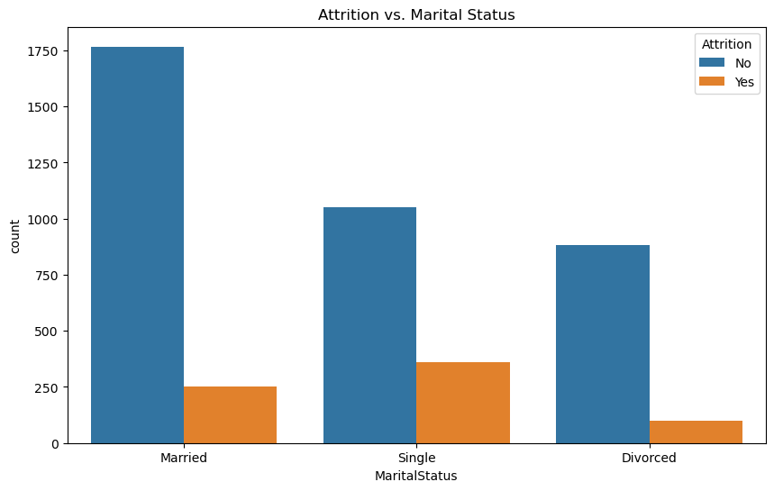
VARIABLES IN DATASET

Slide 12
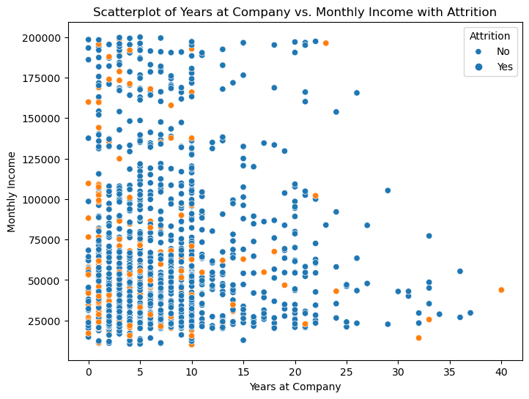
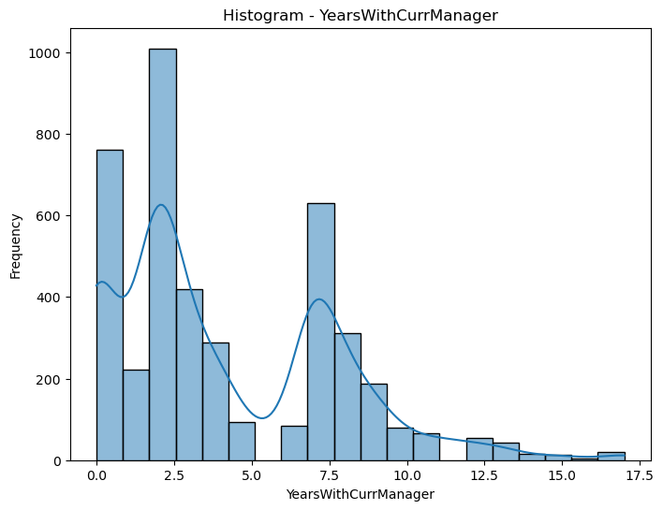
VARIABLES IN DATASET

Slide 13
STATISTICAL
MODELS
EMPLOYED

Slide 14
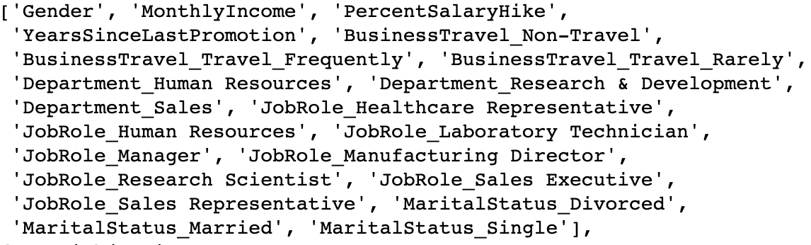
LOGISTIC REGRESSION
Original Fit:
Test Set
Fit after Optimization:
Test Set
Accuracy | Precision | Recall
70% | 58% | 14%
Accuracy | Precision | Recall
80% | 82% | 43%
Optimization methods utilized:
Checking for Multicollinearity,
Scaling/Normalization of Variables
LASSO
Hyperparameter tuning (alpha value)
Notes:
Original fit: 70% accurate but after optimization the model was able to correctly predict the target class for approximately 80% of the instances in the test set.
Optimization methods: Multicollinearity (removed associations with upward of 80%), scaling and normalization of variables such as Education, NumCompaniesWorked, etc. Then i used the lasso just for further feature selection and the selected feature output is shown below. All of these optimization methods collectively led to a large improvement in our ability to accurate predict the target variable.

Slide 15
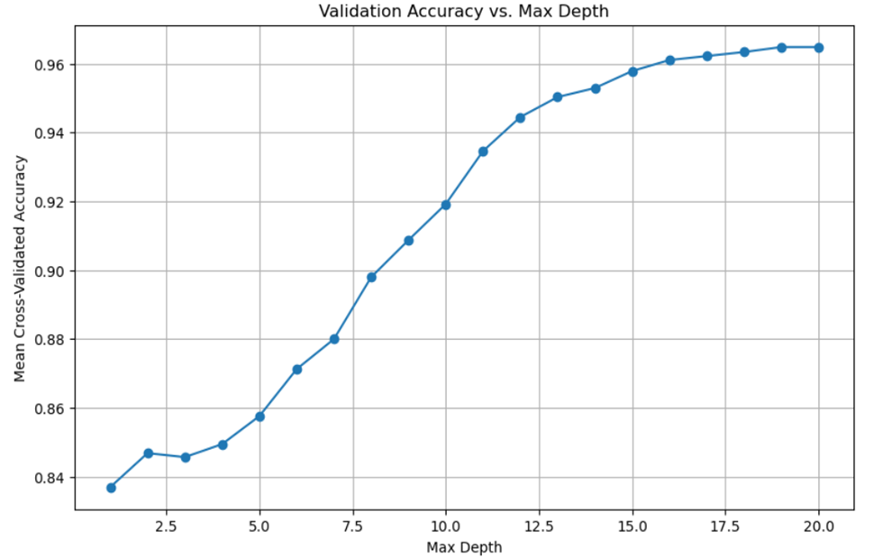
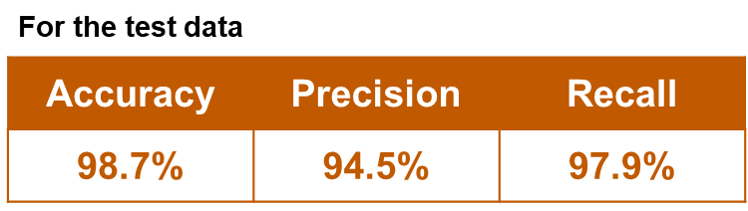
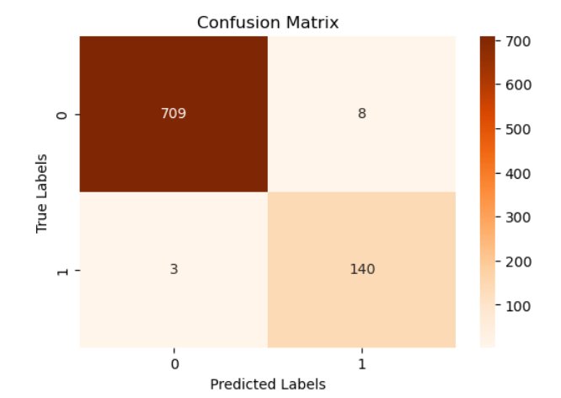
CLASSIFICATION TREE
Notes:
Accuracy of 98%. As shown by the plot, a Max depth of 15 to 16 showed the best improvements to accuracy with nominal improvements to accuracy after that
We also achieved a precision value at 94%, which means that out of all the instances the model predicted as positive, 94% were correctly classified as positive.
The recall value is at 97%, indicating that the model correctly identified 97% of the actual positive instances in the dataset. Which led us to the confusion matrix and the identification of 709 true positives and 140 true negatives.

Slide 16
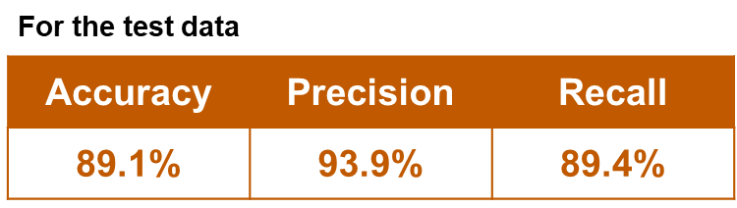
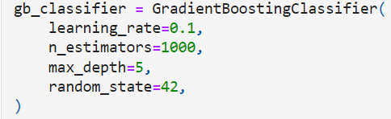
BOOSTING
Based on the results obtained from the initial iteration, hyper-parameter tuning was done to improve the model performance

Slide 17
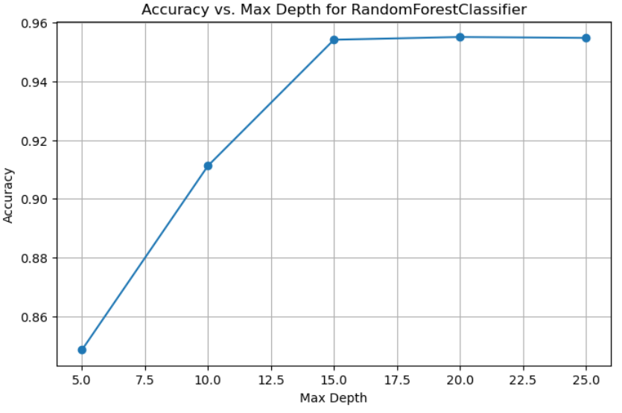
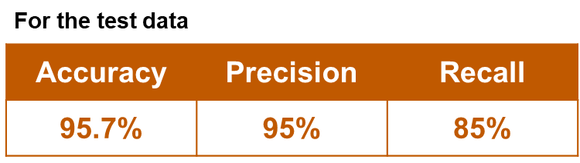
RANDOM FOREST

Slide 18
Model Comparison
 | Accuracy | Precision | Recall
Logistic | 80% | 100% | 43%
Classification | 98.7% | 94.5% | 97.9%
Boosting | 89.1% | 93.9% | 89.4%
Random Forest | 95.7% | 95% | 85%
Based on the different model performances, the Classification Tree methodology yields the best solution for this particular data set

Slide 19
INSIGHTS
AND
CONCLUSION

Slide 20

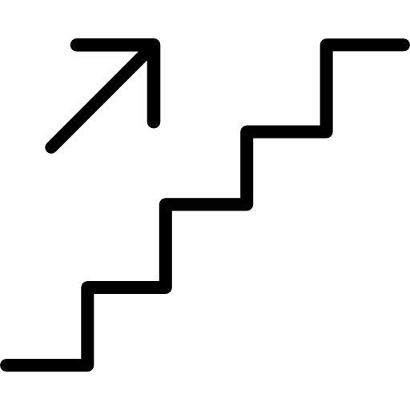
What did we learn?
DIFFERENT MODELS
FEATURE IMPORTANCE
EDA

Slide 21
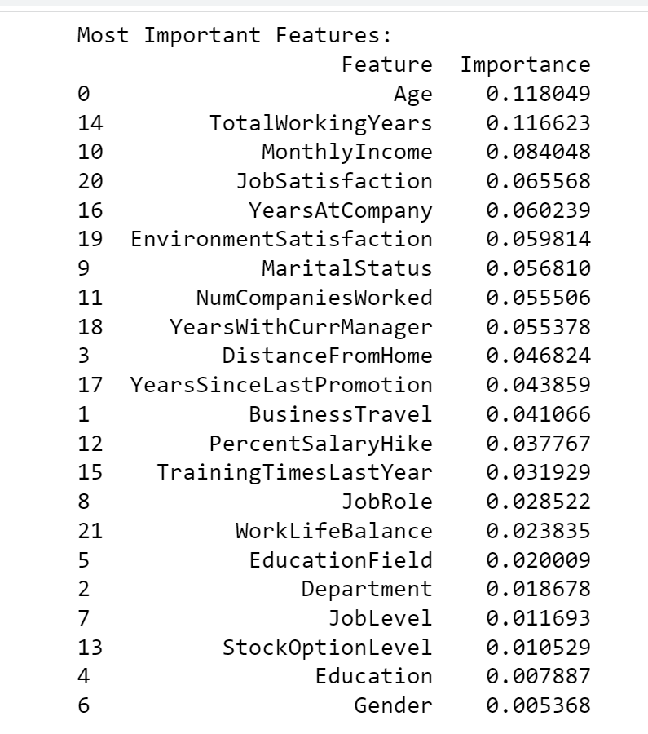
What did we learn?
What should the company do?
Features that play an important role in predicting Attrition

Slide 22
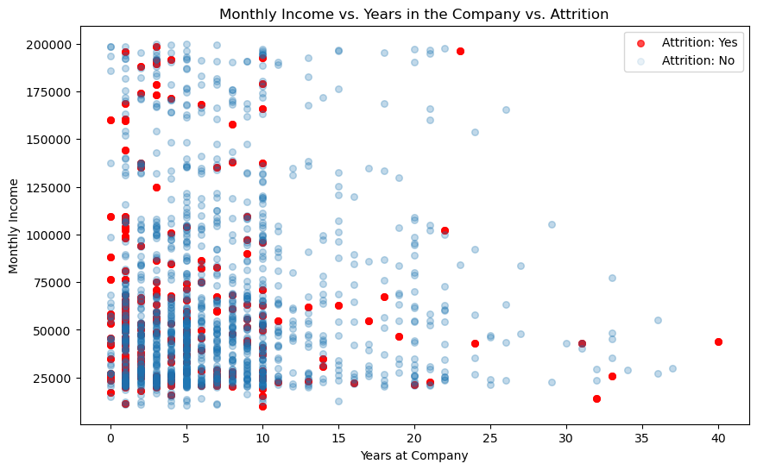
Is it about salary hikes?

Slide 23
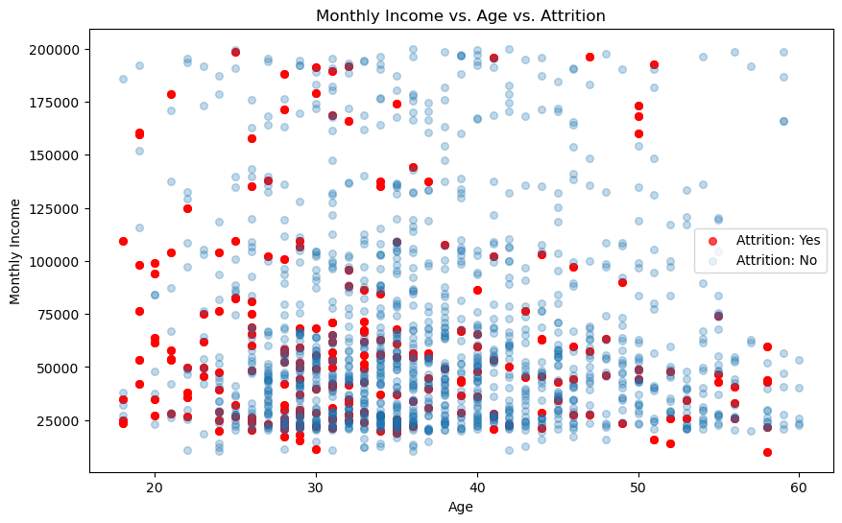
Should they target specific age-groups?

Slide 24
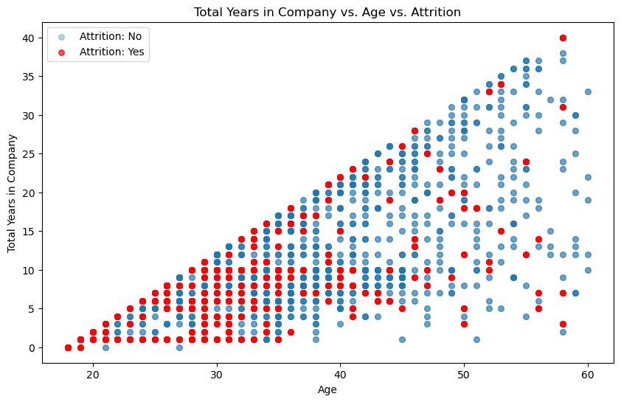
Should they target specific age-groups?

Slide 25
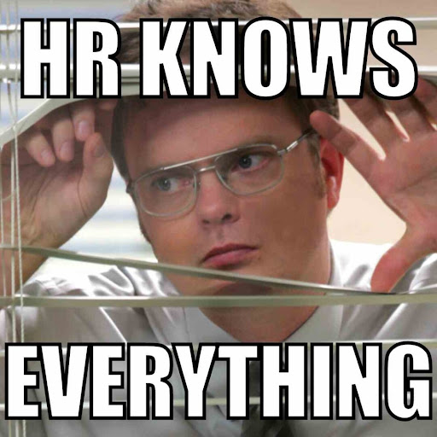
Are employees who have high Job Satisfaction scores
AND
have spent some time working at the company leaving?

Slide 26
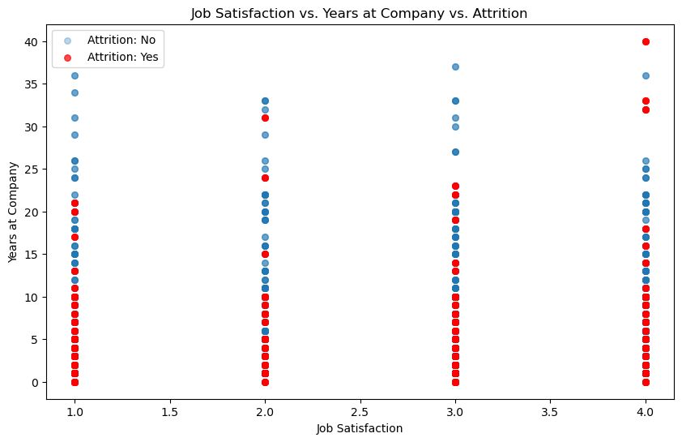
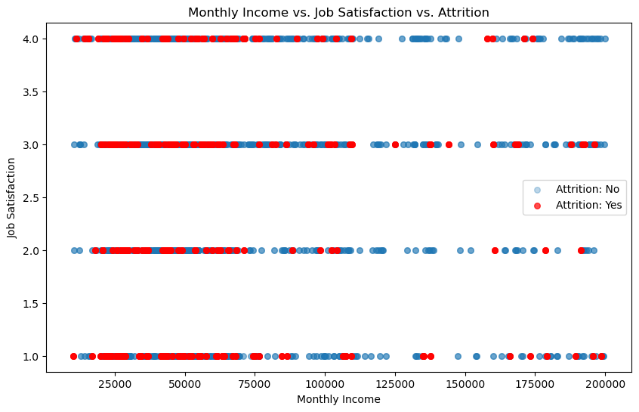
Why are these people who are satisfied with their jobs
AND
get paid like crazy switching?

Slide 27
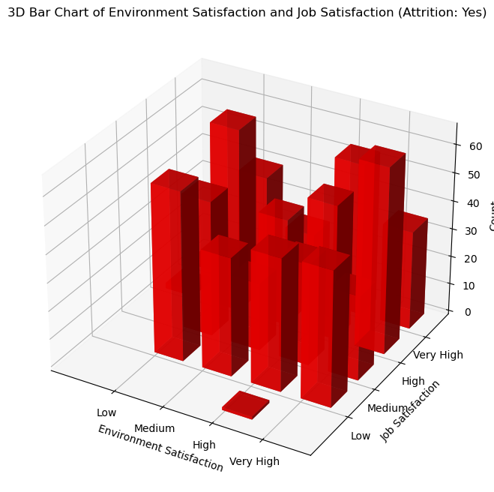
Employees who love their jobs
AND
love the environment
BUT
don’t want to stay?

Slide 28
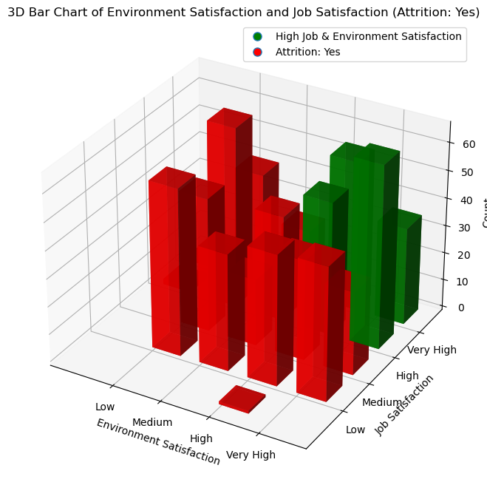
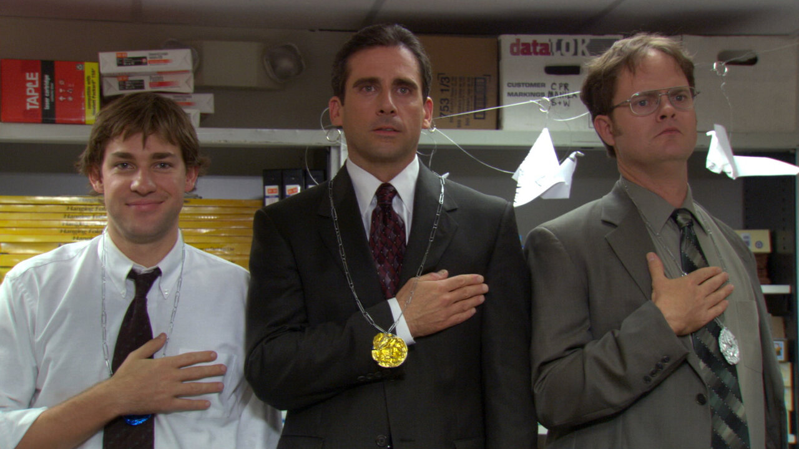

Slide 29
QUESTIONS?

Slide 30
THANK YOU

